Slide 1
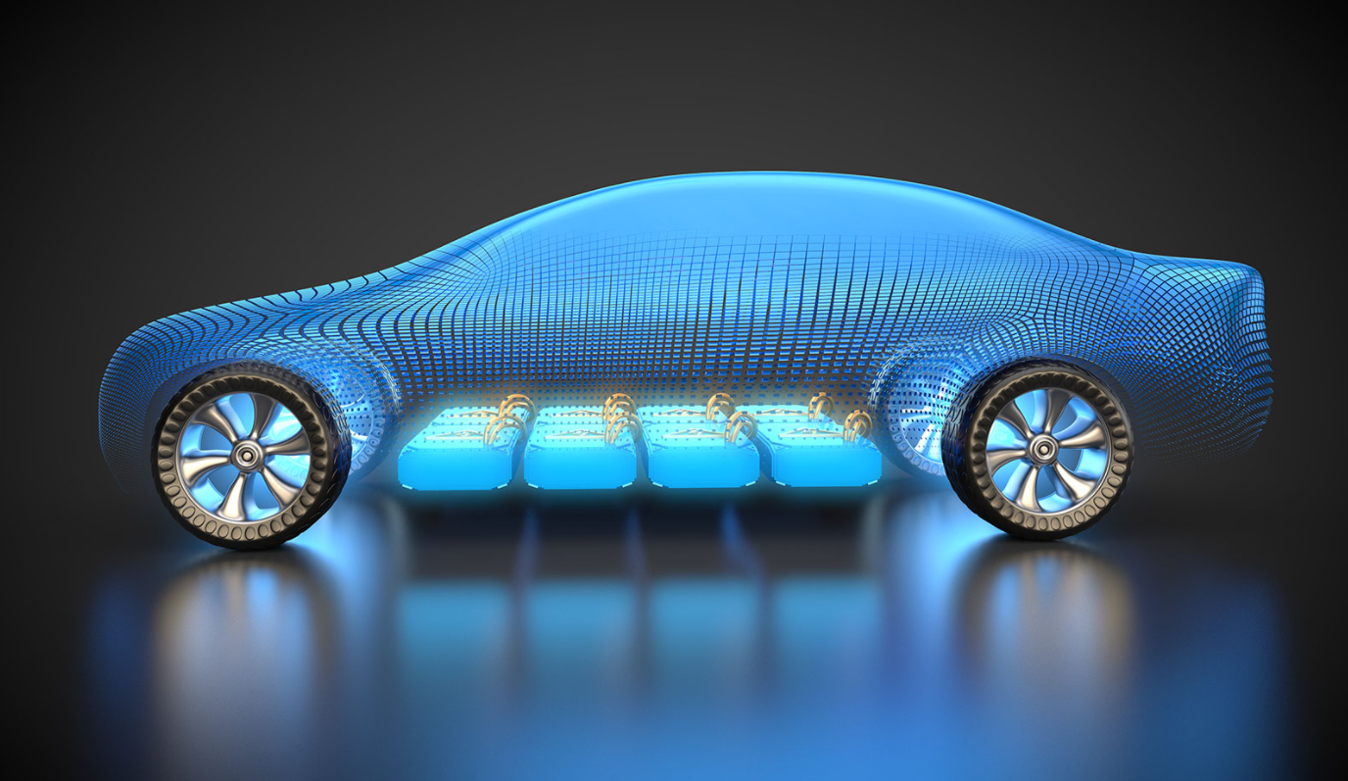
ELECTRIC VEHICLE LITHIUM-ION BATTERY

Slide 2
ESSENTIAL COMPONENTS OF LITHIUM-ION BATTERY
In Lithium-ion battery, electricity is generated through chemical reactions of lithium. Thus, Lithium is an essential component of cathode, however, lithium is very unstable (reactive) in the element form, thus the combination of lithium and oxygen, i.e., lithium oxide is used for cathode. Typically, cathode is made from a chemical compound such as lithium-cobalt oxide (LiCoO2) or lithium iron phosphate (LiFePO4)
Sits between the two electrodes to allow the movement of lithium ions between the two electrodes, however the electrolyte doesn’t let electrons to pass. The electrolyte primarily includes salts and solvents. Salts act as a passage for lithium ion and solvents are organic liquid used to dissolve the salt.
Cathode
Electrolyte
Separator
Placed between the two electrodes to block the flow of electrons inside the battery and prevent short-circuiting, further the separator includes dense micropores to allow the lithium ions to pass through. Typically, separators are made of polypropylene (PP), polyethylene (PE) and other plastics.
Typically made from carbon (graphite), primarily due to its structural stability, low electrochemical reactivity, high lithium-ion holding capacity, etc.
Anode

Slide 3
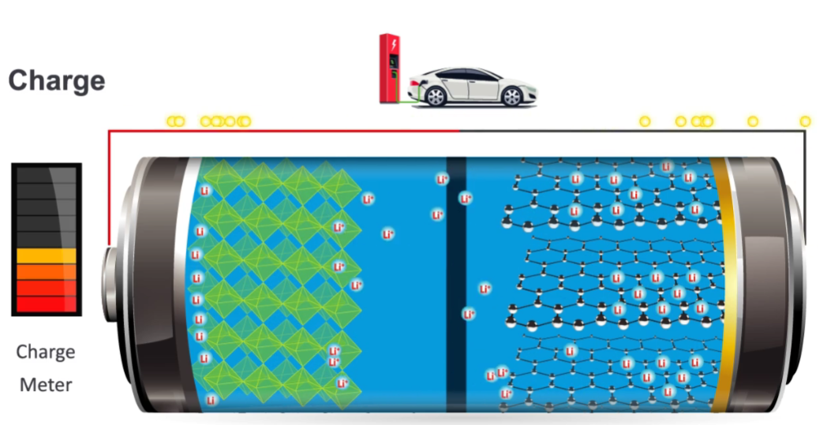
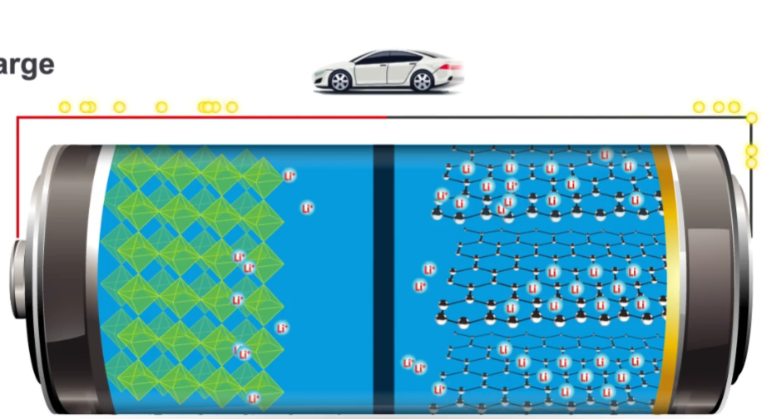
WORKING OF LITHIUM-ION BATTERY
Charging
When battery is connected to a power source, the cathode releases lithium ions and the released lithium ion moves to anode through the electrolyte and the electron through the external circuit.
Discharging/When In Use
When battery is connected to a load or when battery is used, the anode releases lithium ions and the released lithium ion moves to cathode through the electrolyte and the electron through the external circuit, i.e., through the load and thus the current flows from the cathode to anode.
Image Source: U.S. Department of Energy

Slide 4
SHIFT IN TECHNOLOGY FOCUS
Reducing/Eliminating Cobalt Content
Cathode
Electrolyte
Using Solid-state Electrolyte instead of Liquid Electrolyte
Anode
Replacing Graphite with Silicon
Notes:
Cathode: https://www.canarymedia.com/articles/the-many-varieties-of-lithium-ion-batteries-battling-for-market-share/
Liquid electrolyte: https://www.samsungsdi.com/column/technology/detail/56462.html?listType=gallery
https://www.azom.com/article.aspx?ArticleID=20549

Slide 5
STARTUPS- AUTOMOTIVE LI-ION BATTERY MANUFACTURER

Slide 6
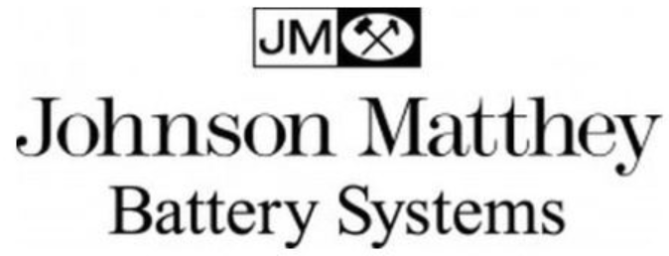
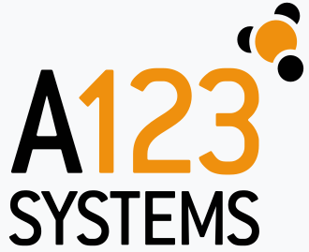
TOP PLAYERS- AUTOMOTIVE LI-ION BATTERY MANUFACTURER

Slide 7
Have a Query, contact us!
E: contact@bayslope.com
P: +1 646-349-9293 (US)
P: +91 844-775-1586 (India)

