Slide 1
October, 2021
VIRTUAL
RAM
INBUILT
RAM
VIRTUAL RAM IN PHONES

Slide 2
INTRODUCTION
Recently, there have been a lot of talks around the topic “Virtual RAM”, as many mobile phone manufacturers are offering virtual RAM feature in their devices, so lets first understand it.
What is Virtual RAM?
It is a technology that virtually increases the amount of total RAM on our phone by using its internal memory (ROM).
ROM
RAM

Slide 3
FAQs RELATED TO VIRTUAL RAM (V-RAM)
What is basic memory Concept?
Broadly speaking, phones include two types of memory, namely a RAM, the volatile memory and a ROM, the non-volatile memory. The ROM is a memory where the data stored remains intact even when the power of the phone is turned off, thus all the data related to various applications is stored in the ROM, however, data accessing speed of ROM is slow. RAM is the memory that loses the data stored in it once the power is turned off. The data accessing speed of RAM is very fast while data accessing speed of ROM is slow. This is why whenever any application is accessed, the data related to the application is moved from the ROM to RAM and then the processor accesses the data from the RAM and executes the application. More the size of the RAM, greater is the processing speed. However, because of the cost associated with the RAM, its size can not be increased to a very high value.
What challenges does V-RAM address?
Now, when multiple applications are accessed/executed parallelly, then RAM storage capacity may reach its maximum limit hence, the performance of the device degrades. This is where virtual RAM (V-RAM) comes into picture, it reserves a portion of a memory in the ROM and allocates it to the RAM when data storage capacity of RAM reaches its limit. The RAM stores some data files in the allocated memory in ROM and thus this memory acts as a virtual RAM.
Is it same as Virtual Memory?
Yes, concept of virtual RAM is same as virtual memory, where a portion of memory of hard disc (ROM) of computer is allocated as a virtual memory for RAM to store data files when RAM runs out of memory.
Does virtual RAM enhance processing speed of the device?
No, the virtual RAM does not enhance the processing speed of the device, instead, it acts as a buffer to store the applications which are less used or not used for a certain duration. Thus, it allows more applications to run parallelly.
Can virtual RAM feature be added via software updates?
Yes, in all the devices with compatible hardware, the virtual RAM feature can be added via software updates.
What are the challenges associated with deployment of virtual RAM in phones?
In phones, solid state devices (SSD) is used as a ROM, here SSD has limited number of write cycles, i.e., the number of time data can be written and/erased is limited. For example, if a portion of SSD is used as RAM, it means data is written and erased multiple times, thus virtual memory feature may impact the overall life of the ROM.

Slide 4
WORKING
Working of the virtual RAM is explained with respect to below images. As illustrated, the mobile phone includes 8 GB RAM and 128 GB ROM and the phone includes virtual RAM feature, which allows the RAM, specifically the processor of the phone to use 3GB of the ROM as a virtual RAM.
When virtual RAM is not Activated
When virtual RAM is Activated
Applications accessed
Applications accessed
App 4
App 5
App 6
App 1
App 2
App 3
App 1
App 2
App 3
Designated Memory for V-RAM: 3GB
Internal Memory: 128 GB
Internal Memory: 125 GB
V-RAM: 3 GB
Total RAM: 11 GB
RAM: 8 GB
RAM: 8 GB
RAM
ROM
RAM
ROM
Fig. 1
Fig. 2

Slide 5
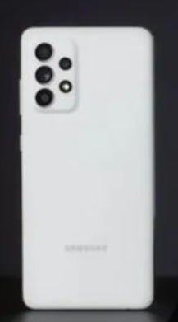
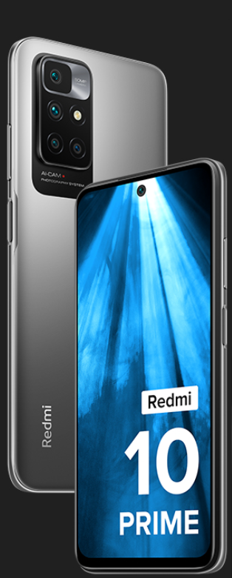
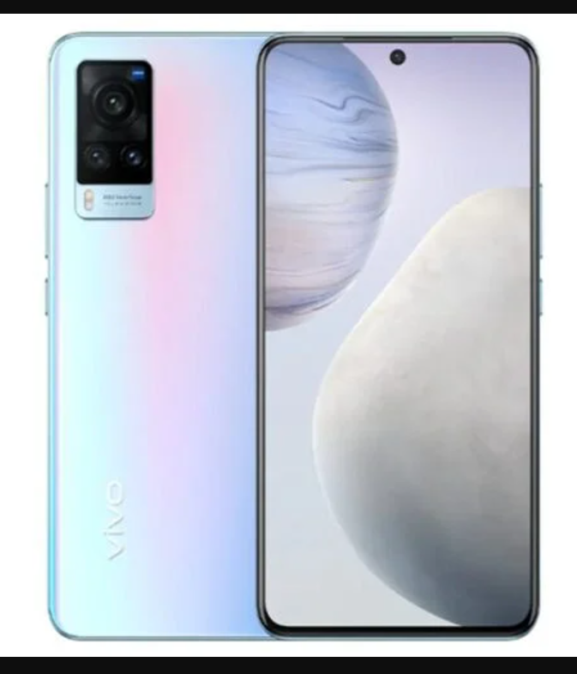
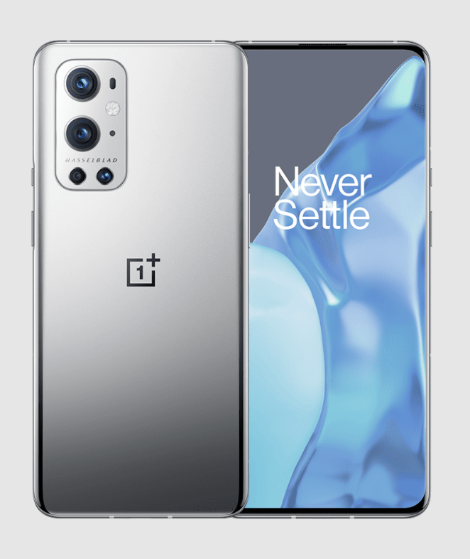
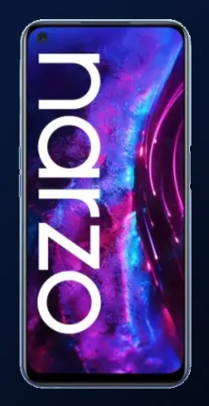
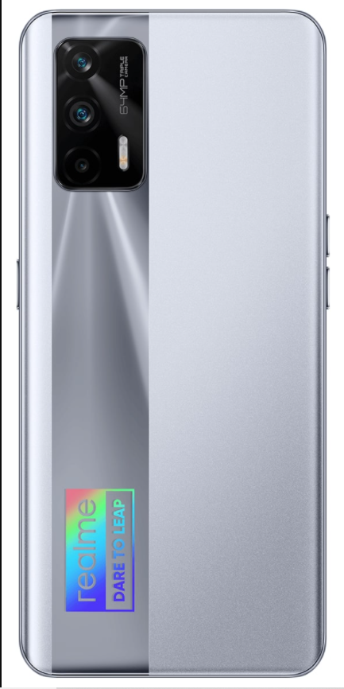
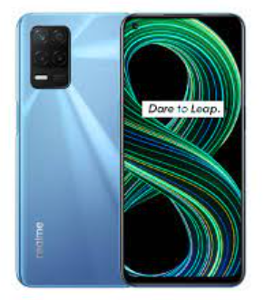
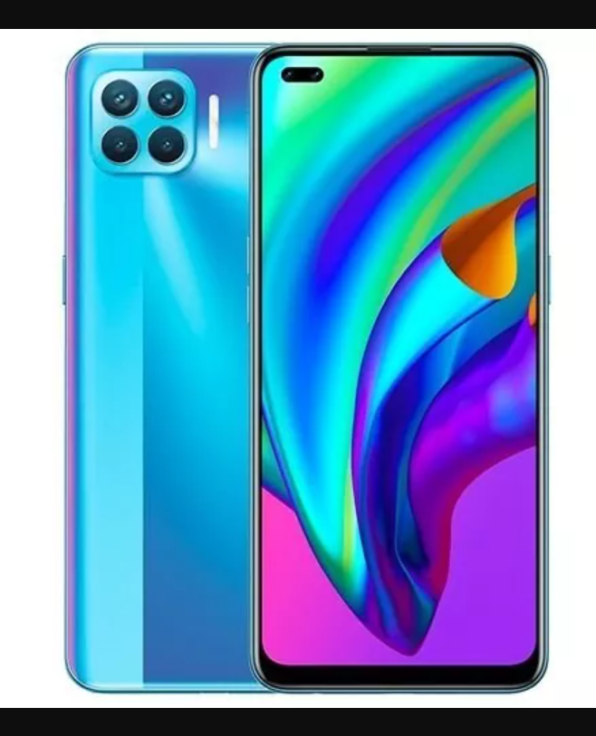
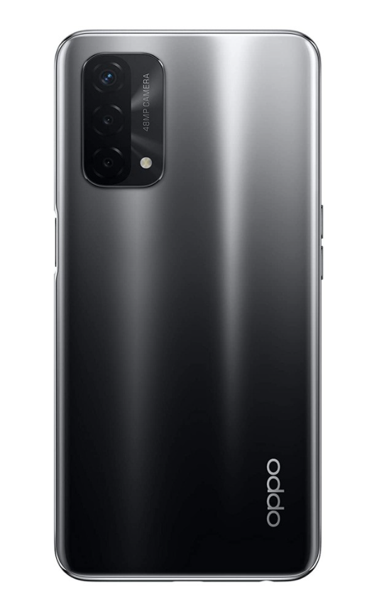
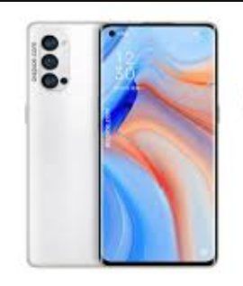
PHONES WITH VIRTUAL-RAM IN CONSUMER MARKET
SAMSUNG
XIAOMI
VIVO
OnePlus
Galaxy A52s
Redmi 10 Prime
Vivo X60
OnePlus 9 Pro
Release: Sep 01, 2021
Release: Sep 07, 2021
Release: Apr 02, 2021
Release: Mar 30, 2021
REALME
Oppo
Narzo 30
X7 5G
Realme 8 5G
Oppo A94
Oppo A74
Oppo Reno 5
Release: Jun 23, 2020
Release: Sep 08, 2020
Release: Mar 25, 2021
Release: Mar 11, 2021
Release: May 10, 2021
Release: Jan 07, 2021

Slide 6
NOTICEABLE PATENT FILERS

Slide 7
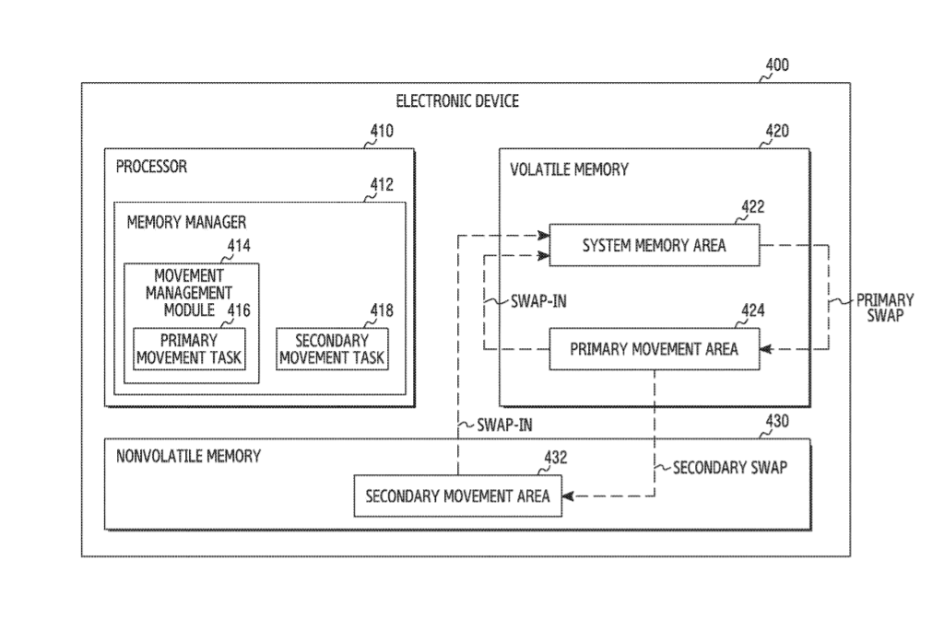
EXAMPLE 1- SAMSUNG’s PATENT: US10831392B2
Title:
Volatile and nonvolatile memory management method and electronic device
Filing Date:
January 11, 2017
Assignee:
Samsung
Bay Summary:
The patent relates to a system for managing memory of a portable electronic device, which includes a processor, a volatile memory (RAM) and a non-volatile memory (ROM). According to the patent, the processor moves data stored in the volatile memory to the non-volatile memory when specified conditions are met. Exemplary specified conditions include a time at which data is stored in the volatile memory, an estimate time at which data is to be stored in the volatile memory, a frequency of use of the data, or a last using time of data.

Slide 8
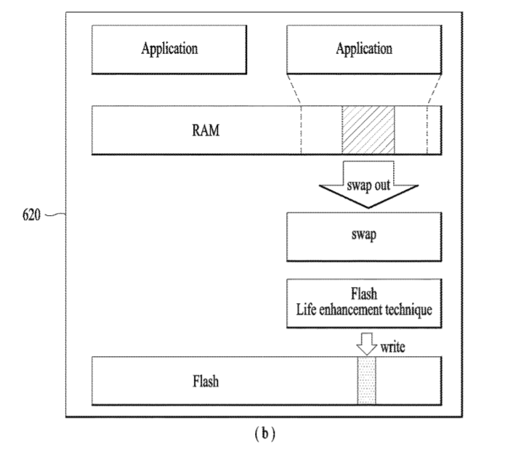
EXAMPLE 2- LG’s PATENT- US20190079876A1
Title:
Digital device and method for controlling the same
Filing Date:
March 13, 2018
Assignee:
LG
Bay Summary:
The patent application relates to a method for controlling a portable device including a first memory (RAM) and a second memory (ROM/Flash). According to the patent application, the second memory is used as a swap space/memory of the RAM, i.e., the space which acts as a virtual memory for the RAM that stores data when the Ram runs out of memory.

Slide 9
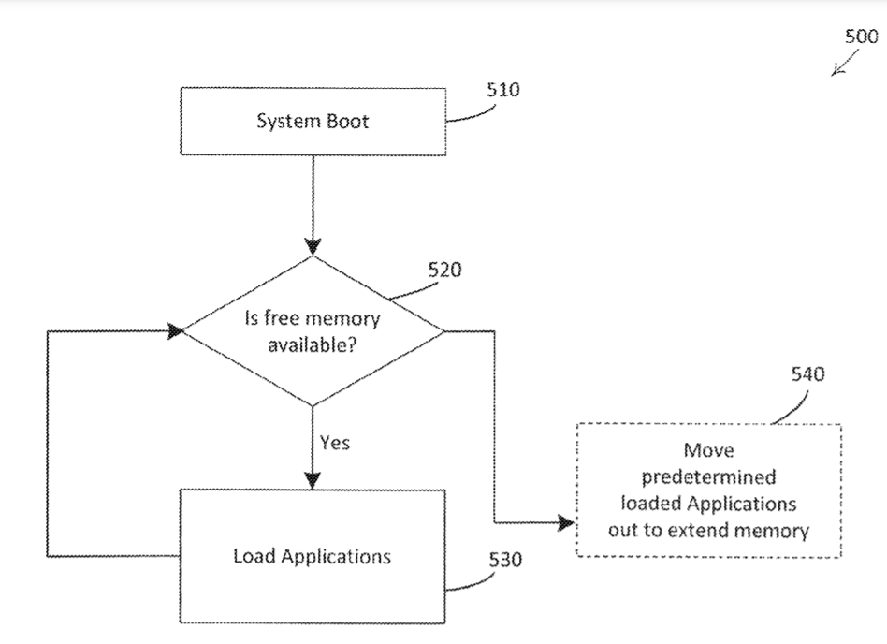
EXAMPLE 3- SANDISK’s PATENT- US9665296B2
Title:
Method and computing device for using both volatile memory and non-volatile swap memory to pre-load a plurality of applications
Filing Date:
May 07, 2014
Assignee:
SanDisk
Bay Summary:
The patent application relates to a method for managing memory of electronic devices including phones, PDAs, or the like. According to the patent, a portion of a non-volatile memory is used as a swap area, i.e., a portion of the non-volatile memory acts as an extension to volatile memory. Both the volatile memory and the non-volatile swap memory can be used to pre-load applications.

Slide 10
This is a quick analysis report, for detailed information, contact us!
E: contact@bayslope.com
P: +1 646-349-9293 (US)
P: +91 844-775-1586 (India)

